Slide 1
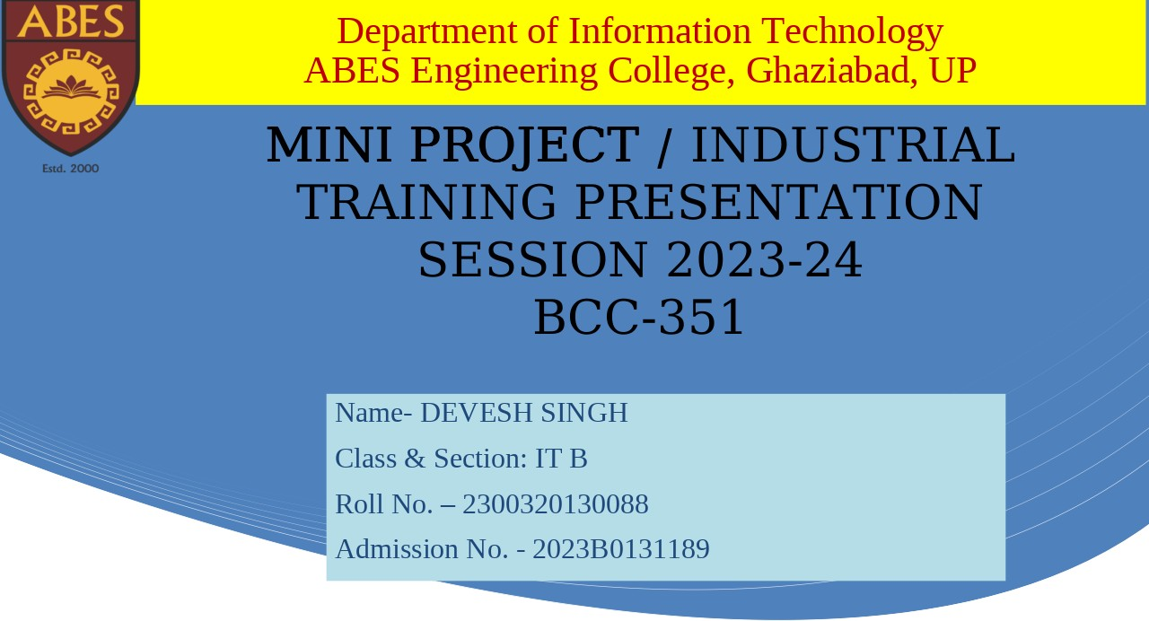

Slide 2


Building a Blinkit
Clone: HTML and CSS Mini Project
This mini project will guide us through building a functional clone of Blinkit, a popular grocery delivery app. We will learn fundamental HTML and CSS concepts and create a visually appealing web interface.
DS
by Devesh Singh

Slide 3

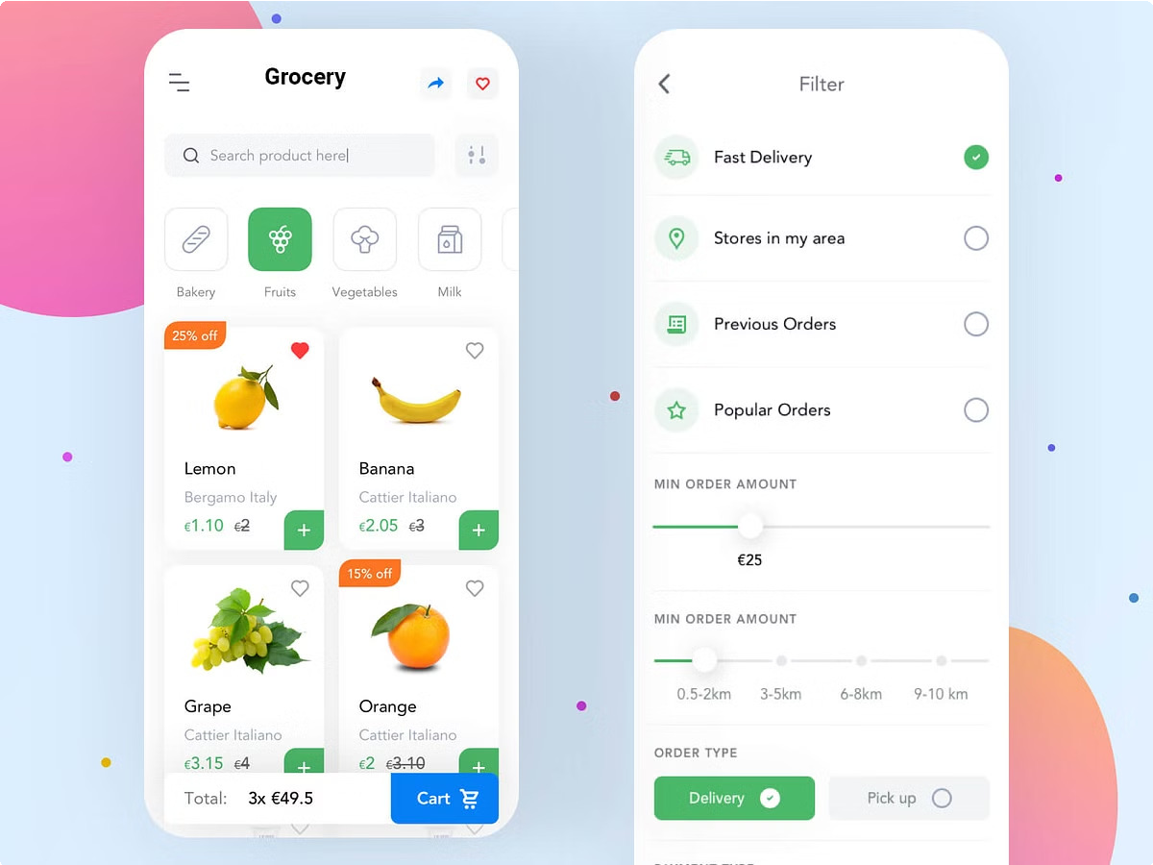
Introduction to Blinkit and Grocery Delivery
1
Blinkit's Features
Blinkit offers fast delivery of groceries and other essential items. Their platform features a wide selection of products and user-friendly ordering options.
2
Grocery Delivery Trends
Grocery delivery services have become increasingly popular in recent years, offering convenience and time-saving benefits.
3
Mobile screens-First Design
Modern grocery delivery apps like Blinkit are designed with mobile users in mind. This requires a streamlined and intuitive user experience for small screens.

Slide 4
Understanding the User Interface
Header
The header will typically display the app logo, search bar, and user account options.
Product Categories
Categorize products to provide easy navigation. You can use a dropdown menu, tabs, or a grid layout to organize product categories.
Product Cards
Each product will be displayed on a card containing an image, title, price, and potentially other details.
Cart and Checkout
Implement a cart to hold selected items and allow users to proceed with checkout. This section will require secure payment integration.

Slide 5
Building the Header Section
HTML Structure
Use appropriate HTML elements like
<header>, <nav>, <ul>, <li> to structure the header section.
CSS Styling
Apply CSS styles such as margin, padding, box-sizing to create the desired visual appearance. Focus on layout, colors, fonts, and responsiveness.
Navigation
Include a navigation menu or dropdown for easy access to different sections of the app. Use styles display; justify-content; align-items; padding to make it more atractive

Slide 6
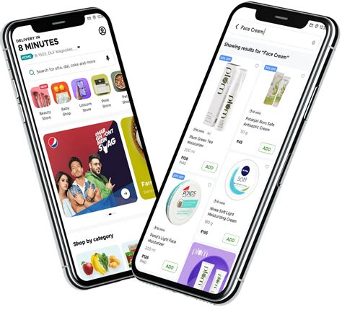
Designing the Product Cards
Product Images
Use high-quality product images and link them under a style tag. Optimize image dimensions for fast loading. This will improve the user experience, making it more enjoyable to browse and find the right products.
Product Titles
Make product titles clear and concise, accurately describing the product.
Avoid using jargon or technical terms that customers might not understand. Make sure the titles are easy to read and scan, so users can quickly find what they are looking for.
Product Prices
Display prices clearly, making sure they're up-to- date. Consider using a currency symbol. The price should be prominently displayed and easy to understand. You can also consider adding a promotional price or discount if applicable.
Add to Cart Button
Include a button to add items to the cart. Use an attractive button style and add some effects. The button should be clearly visible and easy to click. Consider adding hover effects or animations to make it more engaging.

Slide 7

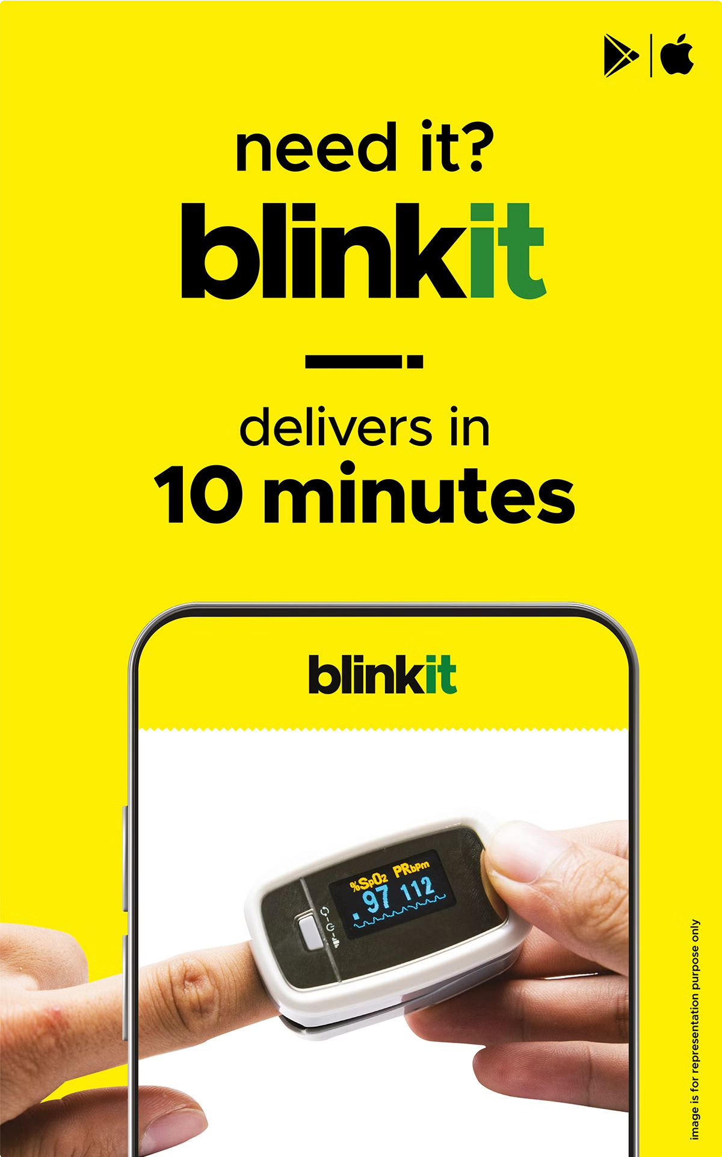
Creating the Cart and Checkout Functionality
Cart Section
1
Display the list of items added to the cart, including quantities and total price.
Checkout Process
Enable users to proceed to checkout by providing a secure payment gateway.
2
Order Confirmation
Display a confirmation page once the order is successfully placed. Include order details and estimated delivery time.
3

Slide 8

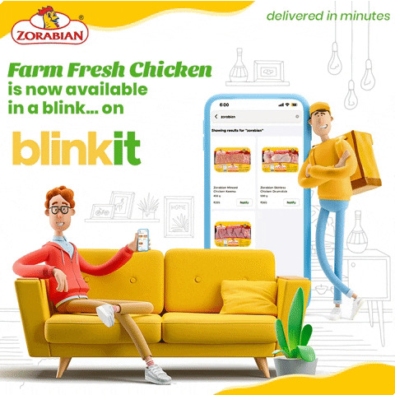
Implementing Responsive Design
Design | Description
Flexible Layouts | Use relative units (percentages, ems) and different styles in CSS to ensure the website adapts to different screen sizes.
Desktop-First Approach | Design for web screens first, then use some other tags to add styles for mobile screens.
Navigation Optimization | Ensure navigation elements are easily accessible and responsive to different screen sizes.

Slide 9
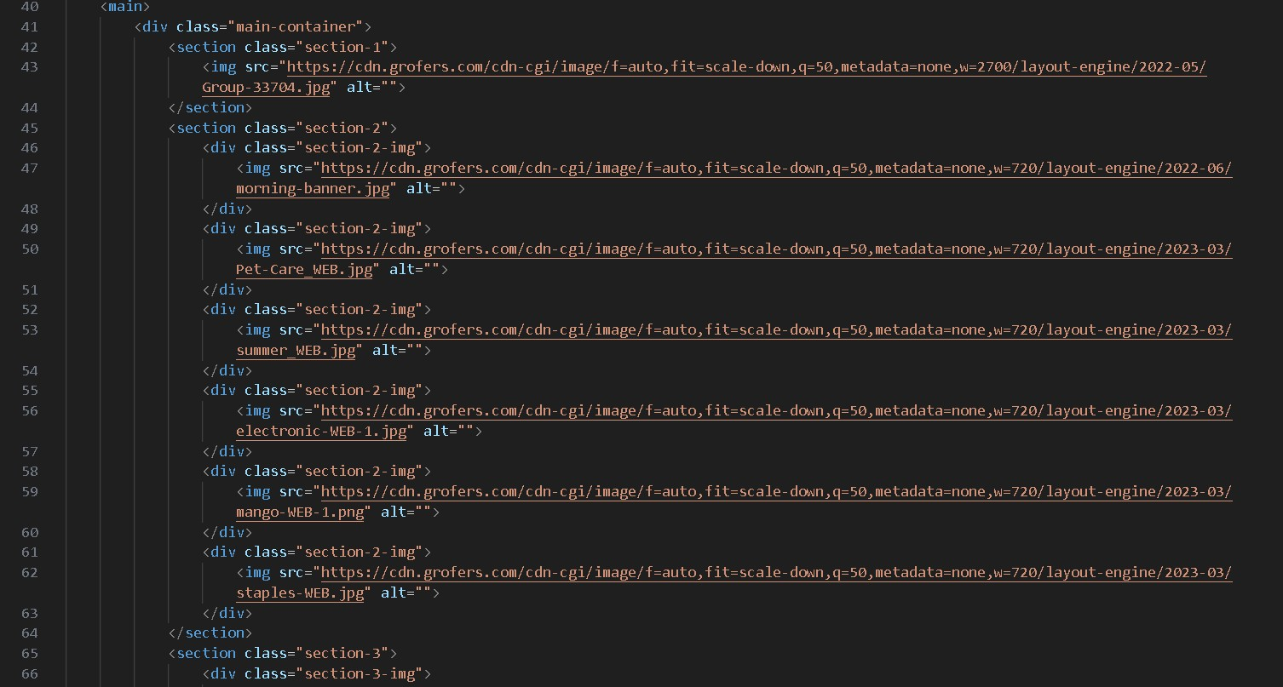
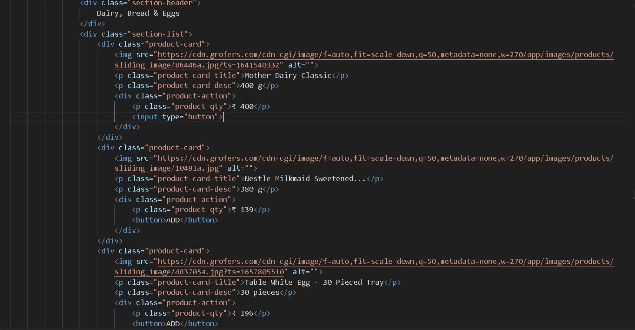
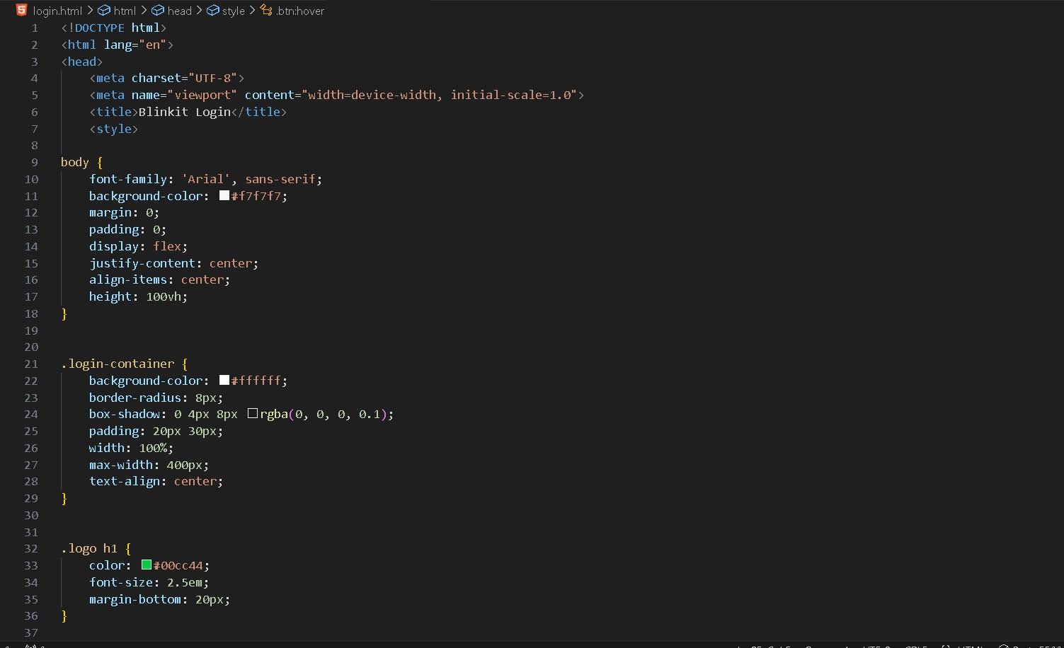
CODE SNIPPETS
LOGIN PAGE

Slide 10
OUTPUT PAGE

Slide 11
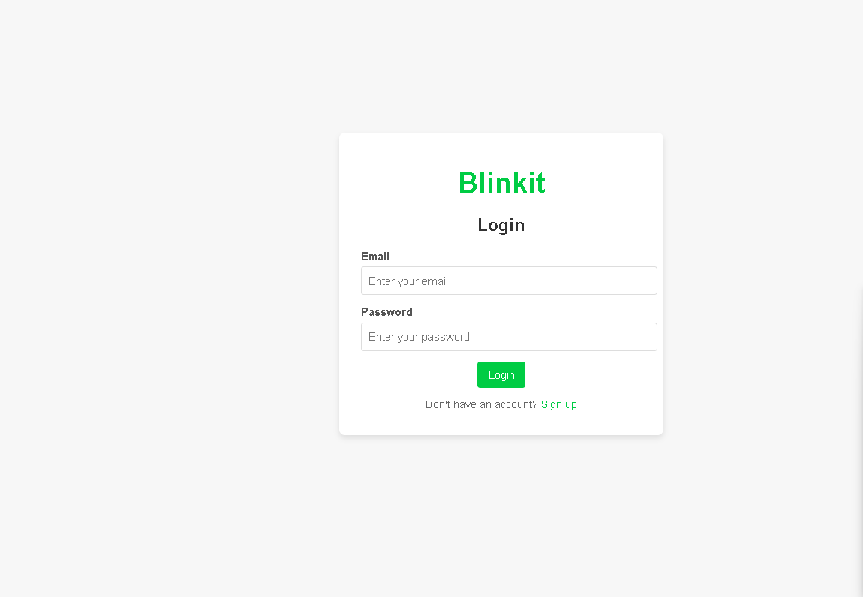
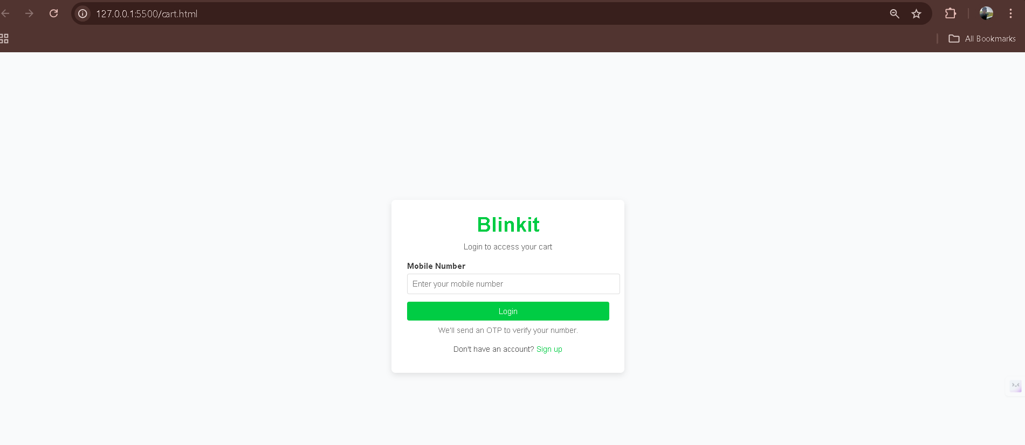
LOGIN PAGE
CART PAGE

Slide 12
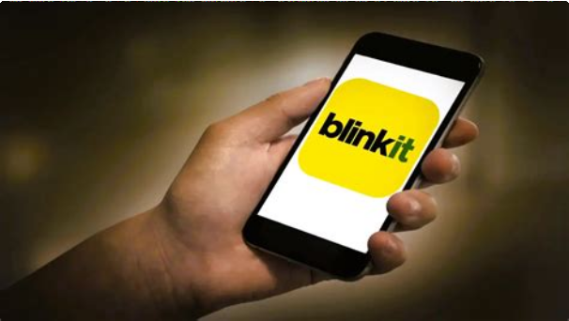
Conclusion and Next Steps
1
Project Completion
I have successfully built a functional Blinkit clone using HTML and CSS.
2
Advanced Features
Explore adding more advanced features cart, login/signup, product filtering, and search functionality.
3
By focusing on these points, my presentation will provide a comprehensive overview of building a Blinkit clone while highlighting essential web development practices.

